Slide 1

MINI-PROJECT-20CS6DCMIP
Project Title:
Automated Volume Control System based on Hand Gestures
Team Members:
Neelam Neha 1DS20CS117
Pratisha F 1DS20CS153
Rachana K 1DS20CS160
DAYANANDA SAGAR COLLEGE OF ENGINEERING
Department of Computer Science & Engineering

Slide 2
ABSTRACT
With advancements in sensor technologies and machine learning,it is now possible to interact with electronic devices using intuitive hand movements and gestures.
Our project aims to offer a more natural and immersive way of adjusting audio levels wherein the users can increase or decrease the volume with their hands without the need of physical devices or buttons. It is implemented using various python libraries like OpenCV for hand detection, Mediapipe for hand tracking ,Pycaw for volume control, Numpy for performing computaions,etc.
DAYANANDA SAGAR COLLEGE OF ENGINEERING
Department of Computer Science & Engineering

Slide 3
PROBLEM STATEMENT/ OBJECTIVES
Problem Statement:
In the modern era, there is a growing demand for intuitive and natural ways of interacting with the technologies. An attempt has been made in this world to control audio levels of systems through simple hand movements using various python libraries like OpenCV, MediaPipe, Pycaw, Numpy ,etc without the need of using physical buttons or digital interfaces to control the volume.
Objectives:
To retrieve the input image or video by using the live camera of the system.
To deploy and implement the capturing of hand landmarks.
Detection and reception of hand gestures to control the volume.
DAYANANDA SAGAR COLLEGE OF ENGINEERING
Department of Computer Science & Engineering

Slide 4
LITERATURE SURVEY
SNO. | TITLE AND YEAR | AUTHOR | METHODOLOGY | REMARKS
1 | Hand Gesture Volume Control using Inertial Measurement Units (IMUs),2023 | Ethan Wilson and et.al | Inertial Measurement Units (IMUs), motion tracking algorithms | This publication makes use of the IMUs and motion tracking algorithms to capture and interpret hand movements to control volume.
2 | Smartphone-based Hand Gesture Volume Control for Mobile Devices,2023 | David Johnson and et.al | Smartphone sensors (e.g., accelerometer, gyroscope),gesture recognition algorithms | This publication presents a smartphone-based hand gesture volume control system designed for mobile devices.
3 | Fusion of Hand Pose Estimation and Gesture Recognition for Volume Control,2023 | James Miller and et.al | Hand pose estimation algorithms, gesture recognition algorithms, fusion techniques. | This study presents a fusion approach that combines hand pose estimation and gesture recognition for volume control.
DAYANANDA SAGAR COLLEGE OF ENGINEERING
Department of Computer Science & Engineering

Slide 5
LITERATURE SURVEY
SNO. | TITLE AND YEAR | AUTHOR | METHODOLOGY | REMARKS
4 | Dynamic Hand Gesture Volume Control based on Hidden Markov Models (HMMs),2022 | Daniel Johnson and et.al | Hidden Markov Models (HMMs), time-series analysis | The gesture volume control is based on Hidden Markov Models (HMMs).
5 | Electromyography-based Hand Gesture Volume Control: A Feasibility Study, 2022 | Laura Davis and et.al | Electromyography (EMG) sensors, signal processing techniques | This publication focuses on the feasibility of using electromyography (EMG) sensors for hand gesture volume control.
6 | Real-time Hand Gesture Volume Control using Depth Sensing Cameras, 2022 | Mark Anderson and et.al | Depth sensing cameras, specifically Microsoft Kinect or Intel RealSense cameras | The authors present a real-time hand gesture volume control system utilizing depth sensing cameras.
7 | Machine Learning Approaches for Hand Gesture-based Volume Adjustment,2020 | Robert Garcia and et.al | Machine learning algorithms, including decision trees, random forests, and support vector machines (SVMs) | This study explores various machine learning approaches for hand gesture volume control.
DAYANANDA SAGAR COLLEGE OF ENGINEERING
Department of Computer Science & Engineering

Slide 6
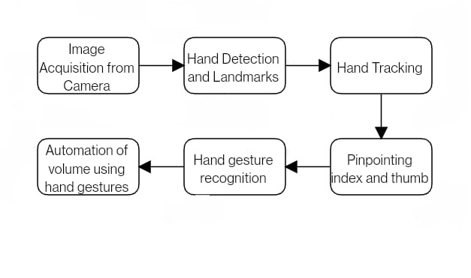
PROPOSED METHODOLOGY
Block Diagram:
DAYANANDA SAGAR COLLEGE OF ENGINEERING
Department of Computer Science & Engineering

Slide 7
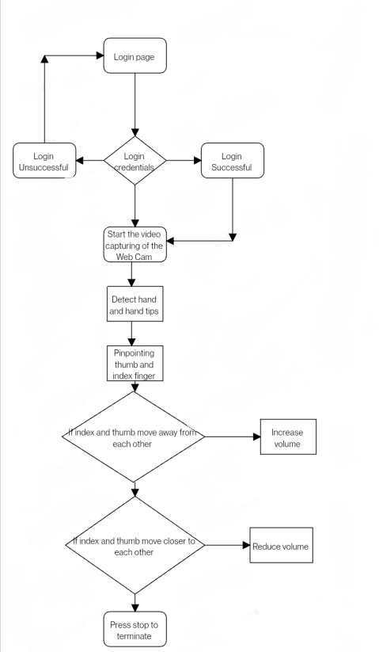


FLOW CHART
DAYANANDA SAGAR COLLEGE OF ENGINEERING
Department of Computer Science & Engineering

Slide 8


SYSTEM ARCHITECTURE
Name of the module: Image acquiring from camera
Description: When the webcam is opened it is captures the hand.
Sample Input:
Sample Output:
Fig.no.1:Web Camera
Fig.no.2: Capturing of hand
DAYANANDA SAGAR COLLEGE OF ENGINEERING
Department of Computer Science & Engineering

Slide 9
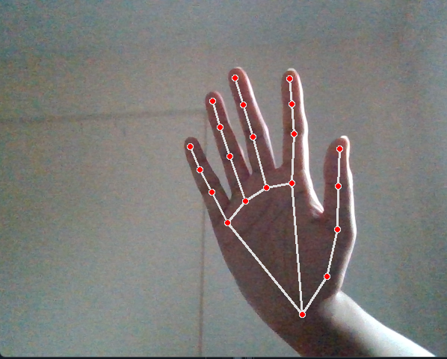
SYSTEM ARCHITECTURE
Name of the module: Hand Tracking and Landmarks
Description: The webcam recognises the hand tracking and captures the landmarks.
Sample Input:
Sample Output:
Fig.no.3: Capturing of hand
Fig.no.4: Capturing hand landmarks
DAYANANDA SAGAR COLLEGE OF ENGINEERING
Department of Computer Science & Engineering

Slide 10
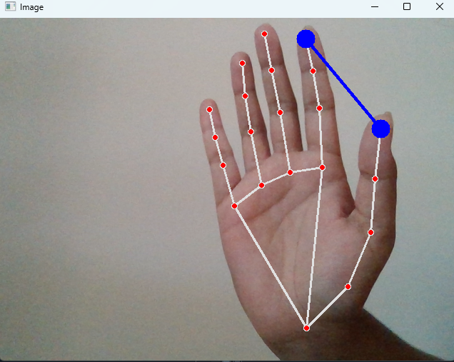
SYSTEM ARCHITECTURE
Name of the module: Pinpointing the index and thumb
Description: The landmarks are captured , the thumb and the index are being pinpointed as these two fingers are being considered as gestures for the volume control.
Sample Input:
Sample Output:
Fig.no.5: Capturing hand landmarks
Fig.no.6: Pinpointing the index and thumb
DAYANANDA SAGAR COLLEGE OF ENGINEERING
Department of Computer Science & Engineering

Slide 11
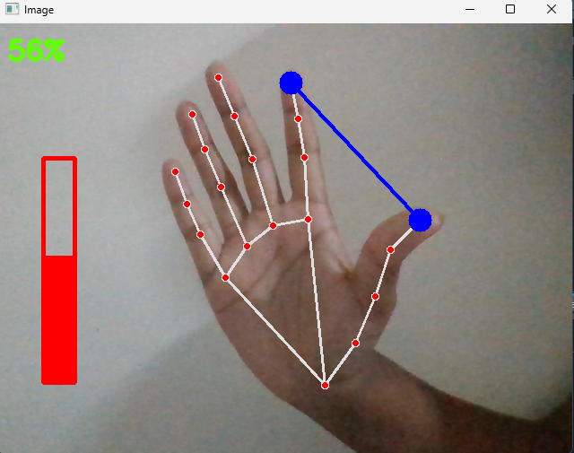
SYSTEM ARCHITECTURE
Name of the module: Volume control
Description: After the landmarks and thumb and index are captured , The volume of the system is varied by the gestures of the two fingers to increase or decrease the volume.
Sample Input:
Sample Output:
Fig.no.7: Pinpointing the index and thumb
Fig.no.8: Automation of volume using gestures
DAYANANDA SAGAR COLLEGE OF ENGINEERING
Department of Computer Science & Engineering

Slide 12
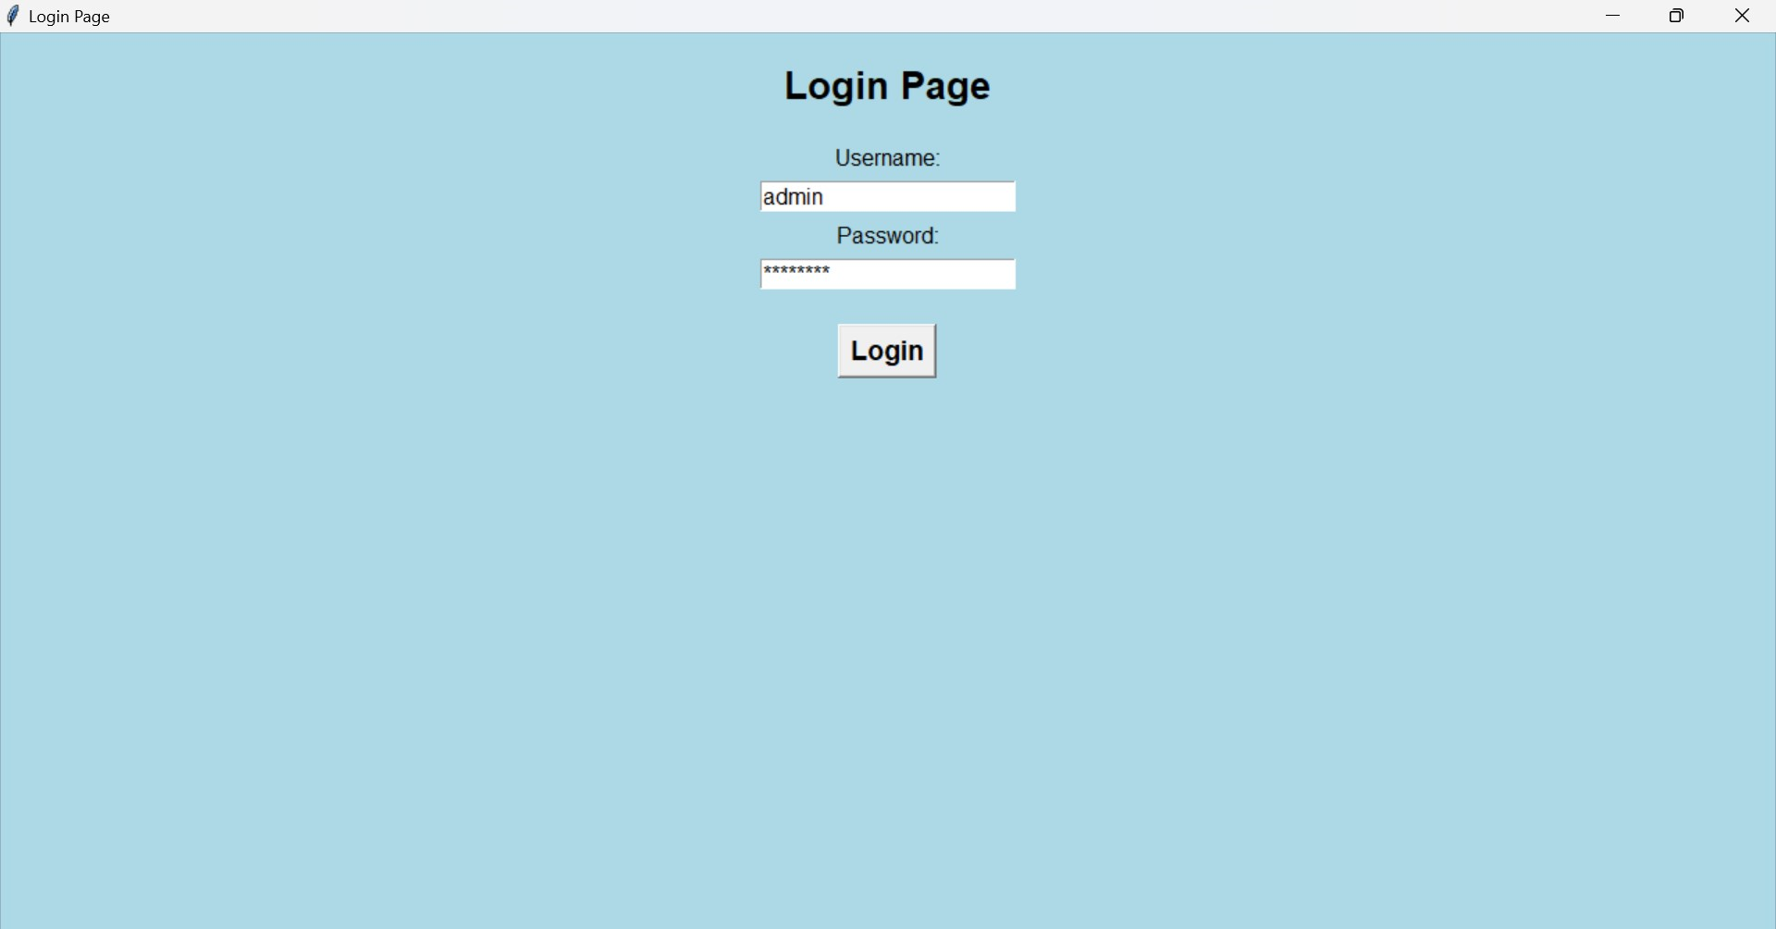
SCREENSHOTS
1. Login Page
DAYANANDA SAGAR COLLEGE OF ENGINEERING
Department of Computer Science & Engineering

Slide 13
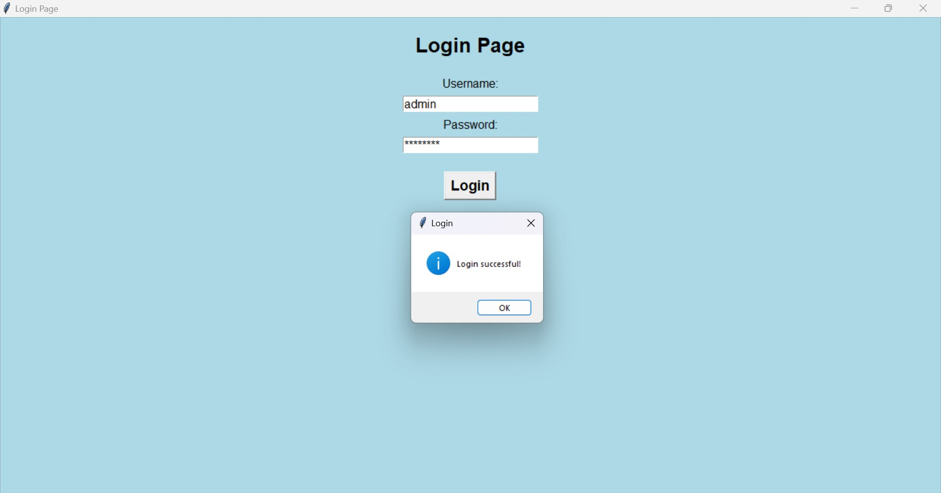
SCREENSHOTS
2. Login Page successful
DAYANANDA SAGAR COLLEGE OF ENGINEERING
Department of Computer Science & Engineering

Slide 14
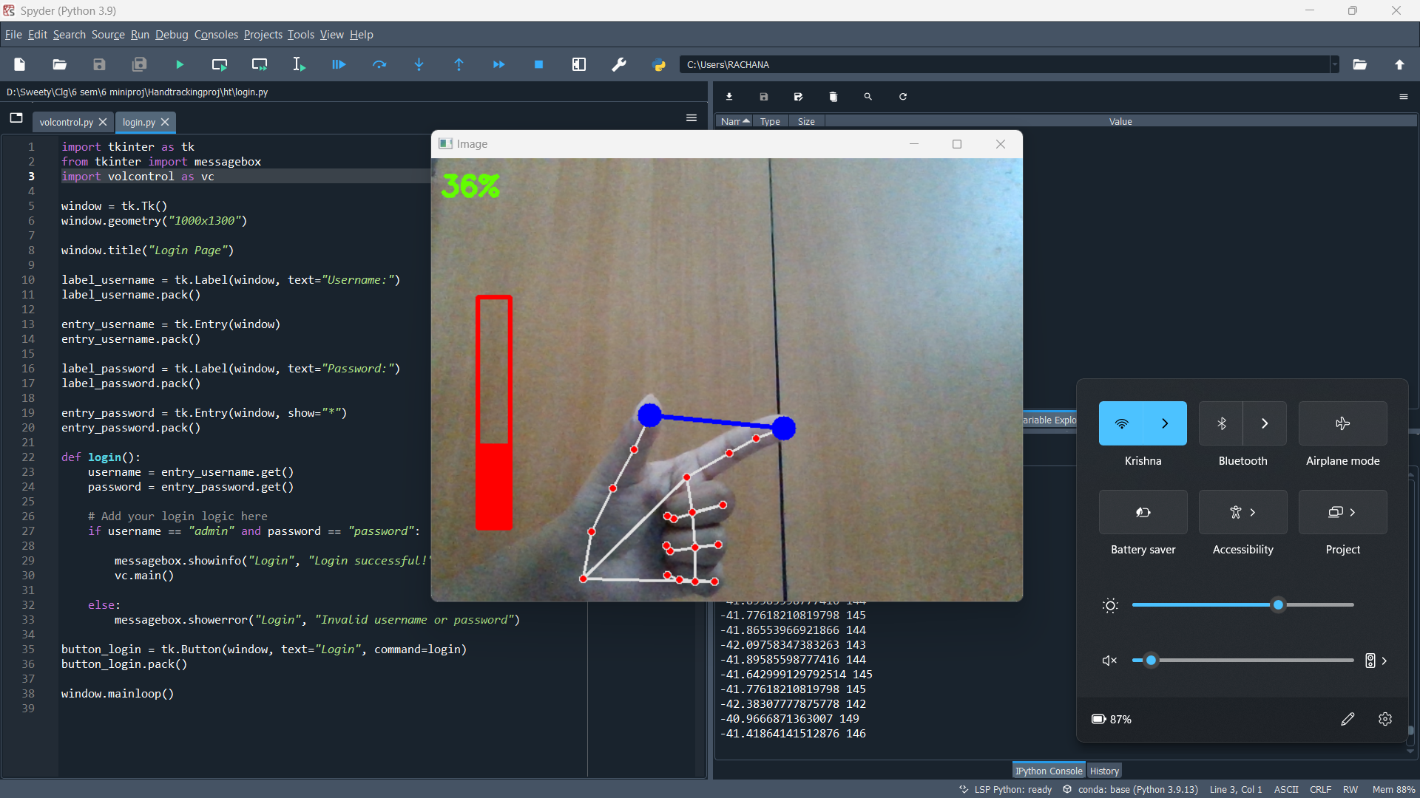
SCREENSHOTS
3. Volume Control using Hand Tracking
DAYANANDA SAGAR COLLEGE OF ENGINEERING
Department of Computer Science & Engineering

Slide 15
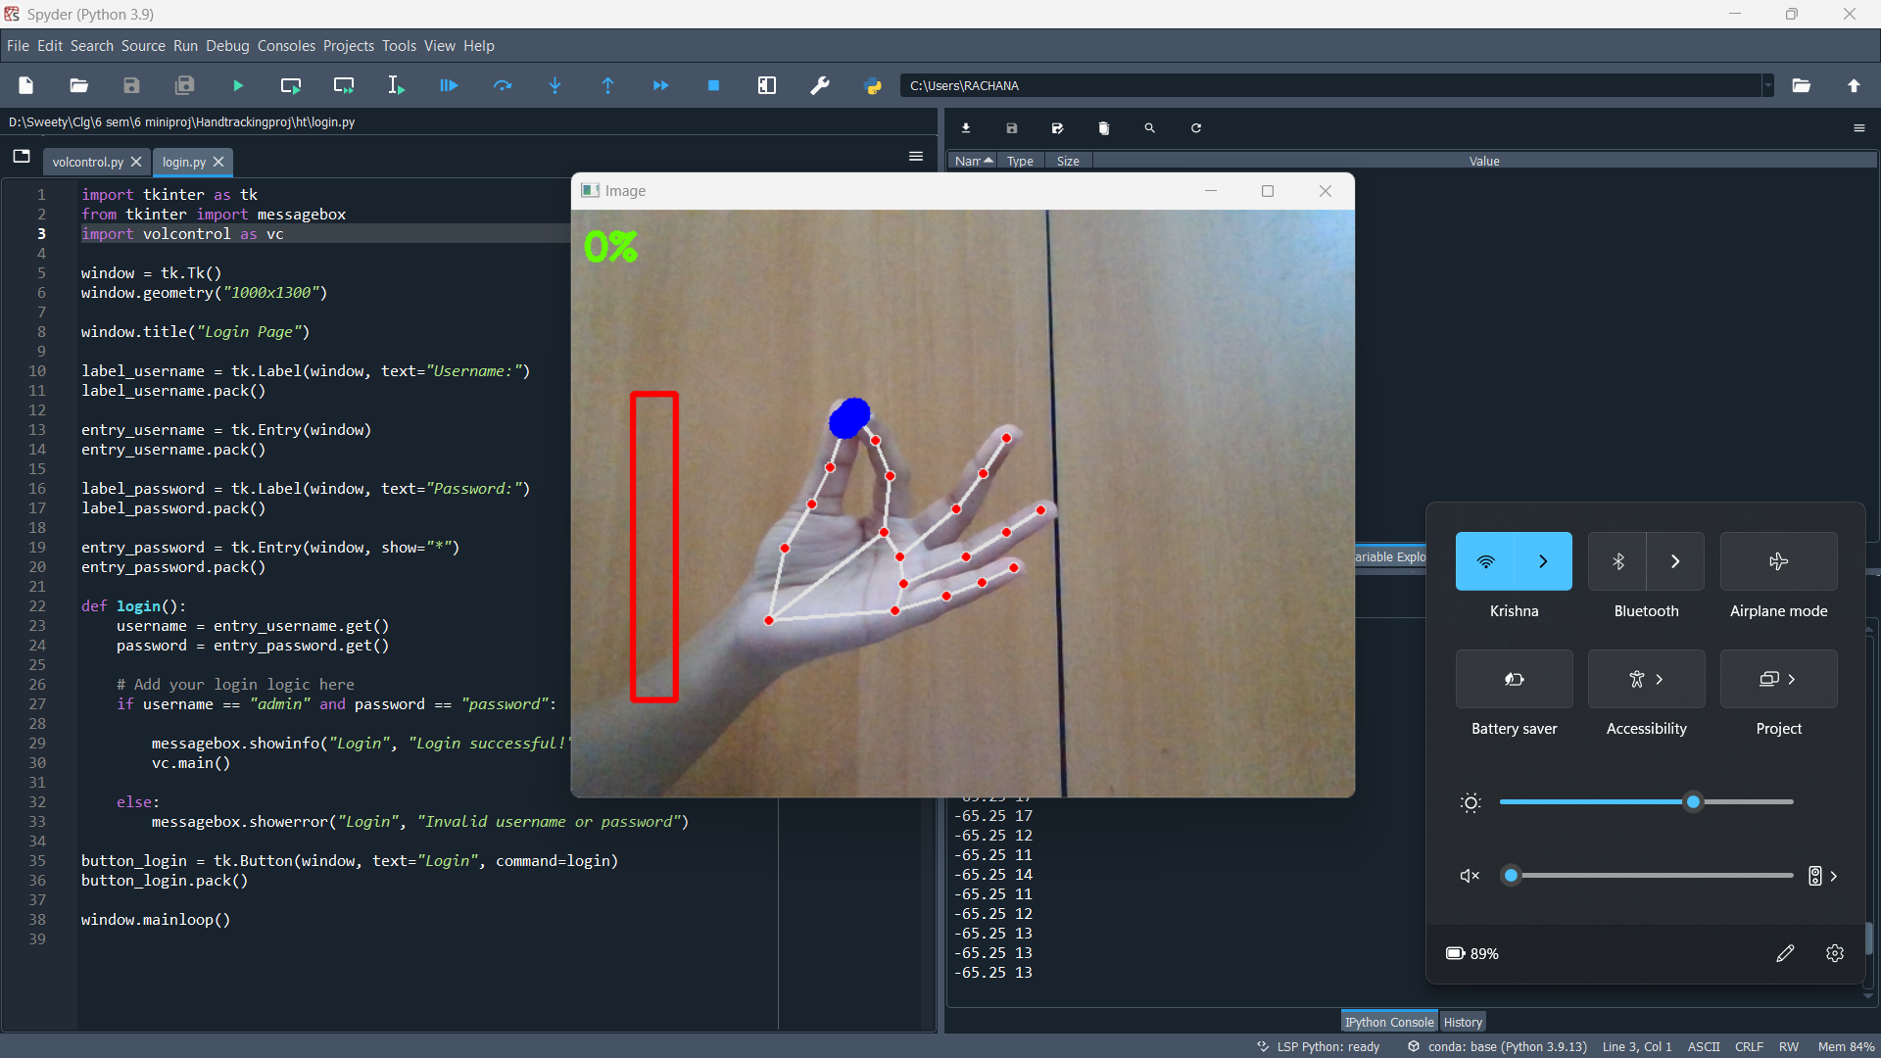
SCREENSHOTS
4. Volume Reduced to 0%
DAYANANDA SAGAR COLLEGE OF ENGINEERING
Department of Computer Science & Engineering

Slide 16
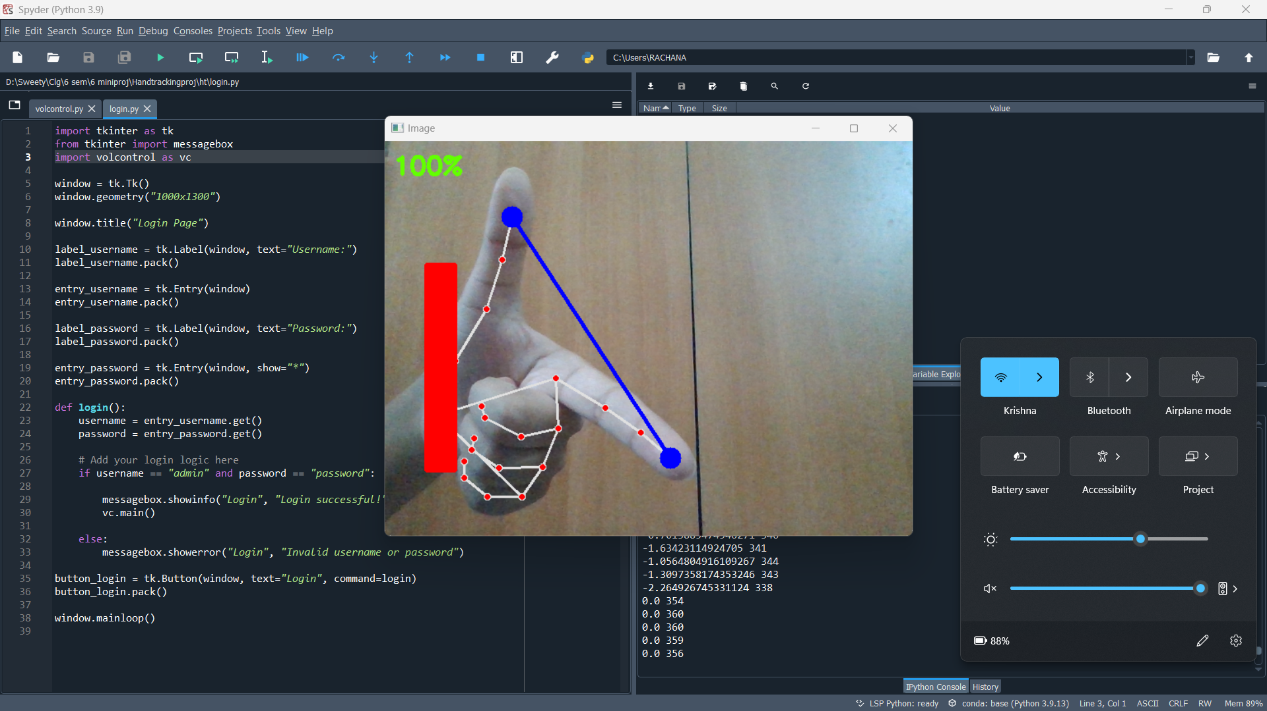
SCREENSHOTS
5. Volume Increased to 100%
DAYANANDA SAGAR COLLEGE OF ENGINEERING
Department of Computer Science & Engineering

Slide 17
INDIVIDUAL CONTRIBUTIONS
1. Neelam Neha - 1DS20CS135 : Implemented the landmark detection part of the gesture volume control and also added few functionalities of code. Helped in setting up UI and testing.
2. Pratisha F - 1DS20CS153 : Helped in linking the login page to the volume control code. Also implemented the tracking of the thumb and index for volume control. Helped in setting up UI and testing.
3. Rachana K – 1DS20CS160 : Added the volume control bar , percentage of volume changing as well as implementing the web cam functionality. Helped in setting up UI and testing.
DAYANANDA SAGAR COLLEGE OF ENGINEERING
Department of Computer Science & Engineering

Slide 18
CONCLUSION
In this mini project , we have made an attempt to automate volume control by using hand gestures. Live feed is captured through real time video of the web cam. In this, the system recognizes hand gestures, hand tracking and 21 hand landmarks. Using this, finally volume control on the physical machine has been achieved.
DAYANANDA SAGAR COLLEGE OF ENGINEERING
Department of Computer Science & Engineering

Slide 19
REFERENCES
[1] "Hand Tracking-Based Volume Control for Virtual Reality Applications“ by Smith, J., Johnson, A. B., & Brown, C. D. IEEE Transactions on Human-Machine Systems, vol. 10, no. 3, pp. 123-135, March 2022.
[2] "Gesture-Based Volume Control Using Hand Tracking" by Anderson, M., Williams, S., & Davis, R. in Proceedings of the IEEE International Conference on Multimedia and Expo (ICME), Los Angeles, CA, USA, July 2023
[3] "Hand Tracking and Gesture Recognition for Audio Volume Control" by Johnson, R., Smith, T., & Thompson, L. IEEE Sensors Journal, vol. 15, no. 7, pp. 4021-4028, July 2015.
DAYANANDA SAGAR COLLEGE OF ENGINEERING
Department of Computer Science & Engineering

Slide 20
REFERENCES
[4] "Dynamic Hand Gesture Recognition for Volume Control in Smart Environments" by Brown, A., Wilson, B., & Davis, P. in Proceedings of the IEEE International Conference on Intelligent Environments (IE), Singapore, July 2020
[5] "Volume Control Using Hand Tracking and Machine Learning" in Proceedings of the IEEE International Conference on Image Processing (ICIP), Vancouver, BC, Canada, September 2018
[6] "Real-time Hand Tracking and Gesture Recognition for Volume Control in Interactive Systems" IEEE Transactions on Human-Machine Systems, vol. 12, no. 2, pp. 567-578, June 2022.
DAYANANDA SAGAR COLLEGE OF ENGINEERING
Department of Computer Science & Engineering

Slide 21
REFERENCES
[7] "Hand Tracking-Based Volume Control for Augmented Reality Applications" by Johnson, M., Smith, R., & Davis, L. IEEE Access, vol. 6, pp. 23456-23467, April 2018.
[8] "Hand Tracking for Gesture-Controlled Volume Adjustment in Smart Homes" by Brown, A., Wilson, B., & Davis, P. in Proceedings of the IEEE International Conference on Consumer Electronics (ICCE), Las Vegas, NV, USA, January 2021
DAYANANDA SAGAR COLLEGE OF ENGINEERING
Department of Computer Science & Engineering

Slide 22
REFERENCES
[9] "Dynamic Hand Gesture Recognition for Volume Control Using RGB-D Sensors," in Proceedings of the IEEE International Conference on Computer Vision and Pattern Recognition (CVPR), Salt Lake City, UT, USA, June 2019
[10] "Hand Tracking-Based Volume Control System for Smart Environments," IEEE Systems Journal, vol. 9, no. 3, pp. 987-996, September 2021.
DAYANANDA SAGAR COLLEGE OF ENGINEERING
Department of Computer Science & Engineering

Slide 23
THANK YOU
DAYANANDA SAGAR COLLEGE OF ENGINEERING
Department of Computer Science & Engineering

